Slide 1
MOBILE RESERVATION LIBRARY SYSTEM
PROJECT MEMBERS
BEYZA YÜKSEL - 201611066
BURCU BİTER - 201512015
EDA GÜL SÜMER - 201611050
ADVISOR
DR. SERDAR ARSLAN

Slide 2

Contents
● Problem
● What is Mobile Library Reservation System?
● Why MLRS is Necessary?
● Previous Similar Works and Contribution
● Solution
● Technologies
● What Happens After MLRS?
● User Interface Design
● Conclusion
● References

Slide 3
Problems
Waste of time
Loss of library cards
Difficult to access
Wait in line
Cannot control all libraries in city

Slide 4
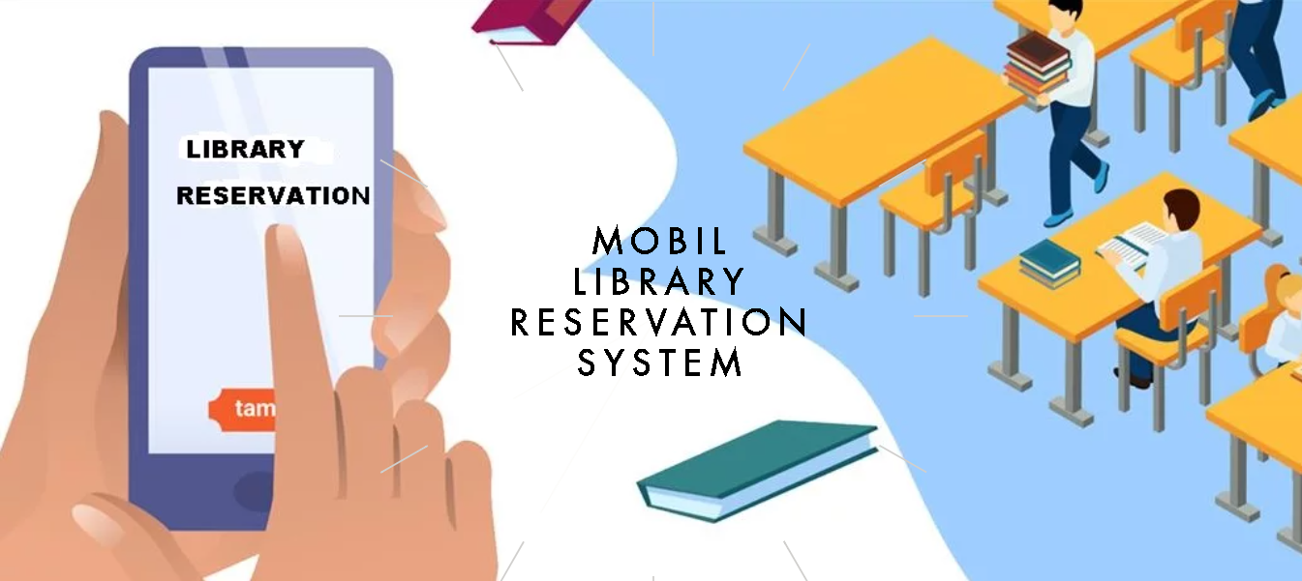
MLRS is a mobile library reservation system.
This project aims to prevent the users from waiting in the library queue by making a reservation in advance and to enable them to choose the table they want to work on.
What is MLRS?

Slide 5

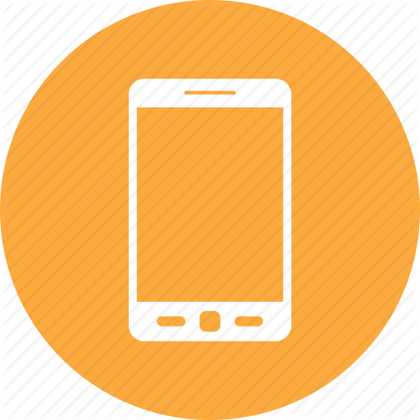
Why MLRS is Necessary?
Easy to Access Library Always
Not Need Library Card
Not Waiting in Line
Avoiding Waste of Time
,
Notes:
Easy To acces library always-
Not need library card-
Not waiting in line-
Avoiding waste of time

Slide 6
Previous Similar Work
PROJECT NAME | AREA | ACCESS | AIM OF PROJECT | PRIVACY | QR CODE
Hong Kong University of Science and Technology Library in China | Library | Web Based | Study Room Reservation for Groups | X | ✓
ODEON E-ticket - ODEON Cinemas in UK | Cinema | Web/Mobile Based | E- Ticket for Movies | ✓ | ✓
Hospital Reservation System in Turkey | Hospital | Web/Mobile Based | Appointment from Hospital | ✓ | X
QR Code Train Ticket Booking in India | Train | Web/Mobile Based | Booking for Train Ticket | ✓ | ✓

Slide 7


Solution
Developing a mobile application that:
çmzf<md
Providing reservation opportunity regardless of and
Cares about user privacy
Removes the library card with the use of QR code
Accessible by using mobile phone
Viewing the occupancy rate of libraries in the city

Slide 8






Technologies

Slide 9
What Happens After MLRS?
Not waiting in the library queue.
Many reservations can be made easily without going to the library.
Reservation cancellation.
Not carrying a library card.
Providing security with personalized QR code.

Slide 10
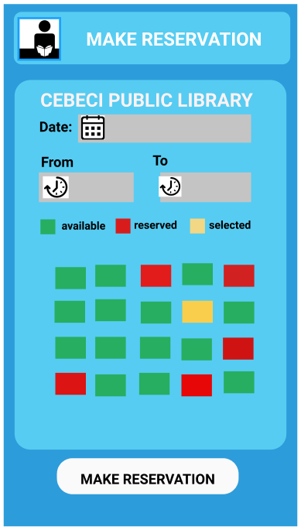
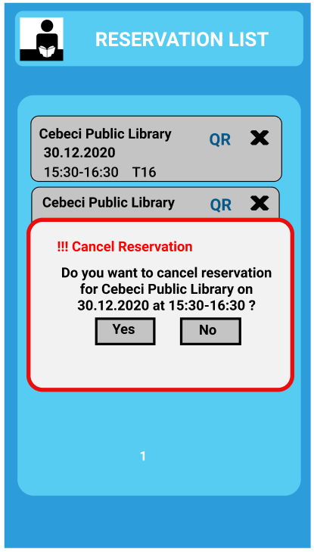
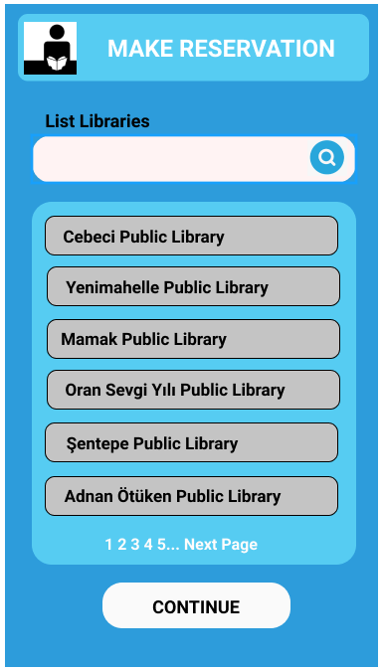
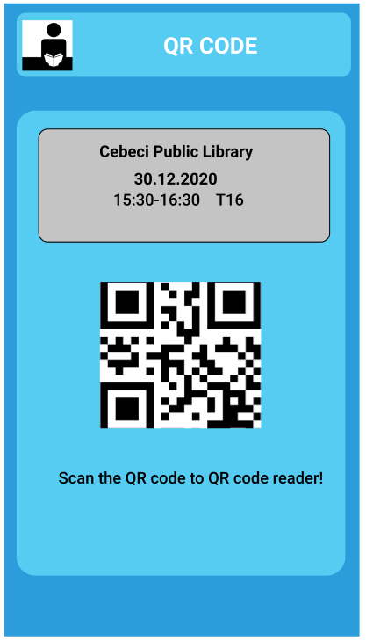
User Interface Design - Library Member

Slide 11
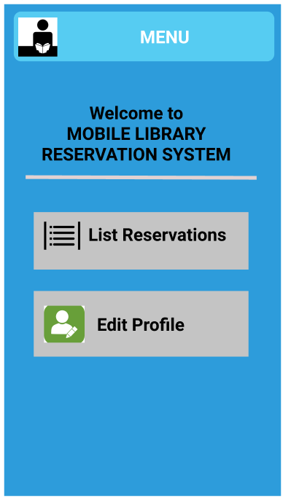
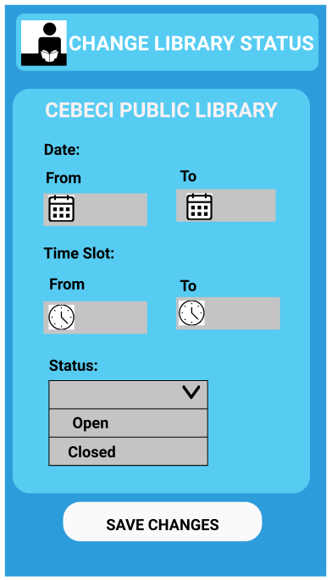
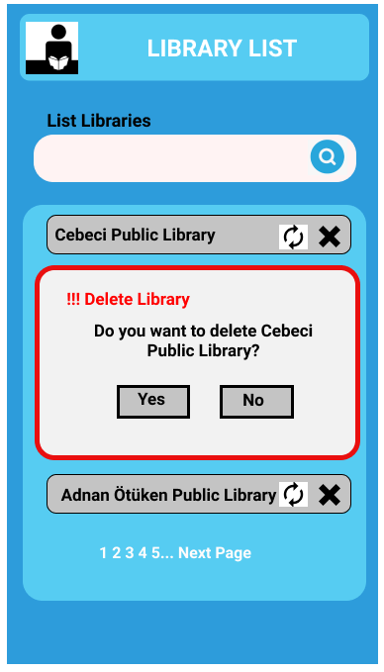
User Interface Design
Librarian Admin

Slide 12
Conclusion
As a result, we will be able to make reservations easily and quickly from the library we want with our project, which we developed by examined previous similar working.
In addition, since this application will be running on many operating systems, it will also appeal to a wide audience.

Slide 13
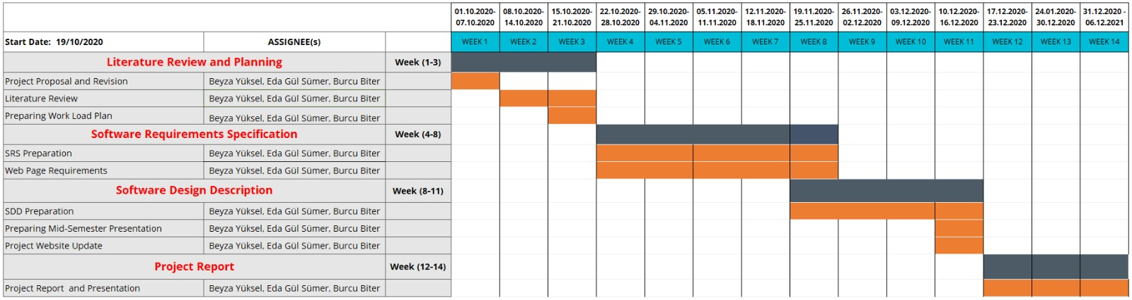
Work Plan

Slide 14
References
[1] Hong Kong University Science and Technology Library Blog https://library.ust.hk/blog/2010/11/15/my-account-for-mobile-devices/
[2] QR Codes for Study Room Booking System used by Hong Kong University Science and Technology Library https://www.youtube.com/watch?reload=9&v=8nY3_1Cl7PE
[3] ODEON E-Tickets https://www.odeon.co.uk/e-ticket/
[4] CDAS Mobile Application for IOS https://apps.apple.com/tr/app/mhrs-mobil/id589804718
[5] MHRS Mobile Application for Android https://play.google.com/store/apps/details?id=tr.com.innova.fta.mhrs
[6] UTS - Centre for Railway Information Systems https://apps.apple.com/in/app/uts/id1357055366
[7] QR Code for Train Ticket Booking https://www.irctchelp.in/qr-code-for-train-ticket-booking/

Slide 15
THANK YOU FOR LISTENING

